Slide 1
Christian Methodist Episcopal Church Strategic Plan Overview Eighth Episcopal District July – August 2022

Slide 2
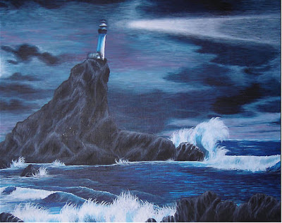
The Visible Horizon
A Senior Leadership Team’s Unique Responsibility
Ignite Possibility
Create Alignment and Focus
Ensure Long-term Viability

Slide 3
Sustainable Growth Framework
Aligned Leadership
Purpose, Vision, Mission, Values, Management System
R
E
S
U
L
T
S
Strategy
Execution
Capability
Culture
Adapted from “Winning Through Innovation”, Michael Tushman & Charles O’Reilly III, Harvard Business School Press

Slide 4
What is a Strategic Plan?
The output of an organization’s process to define its long-term direction and align its resources to pursue goals tied to that direction
CME Church Strategic Engagement Team

Slide 5
The strategic plan is aimed at 3 critical areas of growth & development for the CME Church:
Be BOLD: Face Now – Embrace Next – See New
Discipleship
Vibrant Church
Ministries
Individuals
The Connection
Communities
Congregations
CME Church Strategic Engagement Team

Slide 6
Foundational Elements for Strategic Alignment
Highest Purpose
Why we exist beyond anything measurable or quantifiable
Mission
Vision
Who we aspire to become
Enduring shared beliefs about what we stand for and what’s acceptable throughout the CME connection
What we are called to do
Core Values

Slide 7
CME Church’s Highest Purpose
To proclaim and demonstrate the liberating power of God’s love by offering Jesus the Christ, who transforms lives, communities and the world

Slide 8
CME Church’s Mission
To be disciples of Jesus the Christ by serving individuals, communities and the world as:
witnesses to God’s salvation and grace
representatives of the loving presence of God
advocates for social justice and equality
proponents of economic and educational development

Slide 9
CME Church’s Vision
To be a loving and nurturing church, winning souls and empowering people to fulfill their destiny as disciples of Jesus the Christ.

Slide 10
CME Church’s Core Values
Aligned
Working toward a common focus
Authentic
Being real in all things
Effective
Periodically evaluating whether we are accomplishing the goals
Focused
Setting smart goals with measurable outcomes
Forward Looking
Going above and beyond with a faith vision
Intentional about Accountability and Responsibility
Holding oneself and others to task; having an “if it’s to be, it’s up to me” attitude
Loving
Embracing the sacredness of self and others
Social Justice Oriented
Liberating the oppressed, led by biblical mandates
Notes:
And the values, which are those enduring shared beliefs that all CMEs embrace, are these: aligned, authentic, effective focused forward looking, intentional about accountability and responsibility, loving and social justice oriented.
It was important to define the values to ensure the meanings of each word or phrase are clear to all and everyone can participate in the church environment where these values are embraced and accepted as the standards of behavior for all.

Slide 11
General Conference 2022
Strategic Plan Video
6 Goals
6 Strategic Initiatives

Slide 12
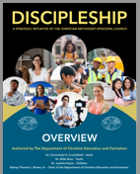
Strategic Goal 1 By June 2026, the CME Church will have delivered and promoted a Spiritual Discipleship Ministry (SDM) in which 100% of our local churches will be active participants | Strategic Initiative I Develop and pilot a Discipleship Program | Co-owners Dr. Carmichael Crutchfield Bishop Teresa Jefferson-Snorton

Slide 13
Strategic Goal 2 By June 2026, the CME Church will have dramatically increased our impact internationally as evidenced by: # of focused missions and partnerships # of operationally sustainable and funded projects | Strategic Initiative II Establish a clearly defined structure to consistently support and manage CME mission work | Co-owners Bishop James Walker Dr. Pene’ Woods

Slide 14
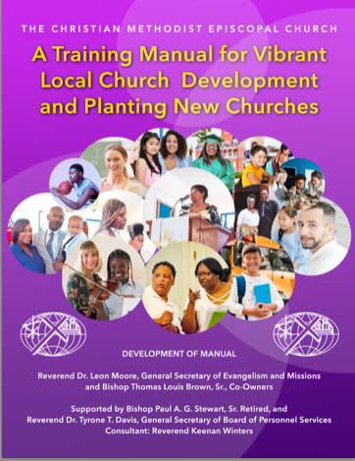
Strategic Goal 3 By June 2026, the CME Church will have increased the overall healthy church profile throughout the denomination by: Creating a Vibrant Church initiative with 80% of local pastors and churches Deploying Vibrant Church standards Planting new churches | Strategic Initiative III Church Growth Initiative | Co-owners Bishop Thomas Brown Rev. Dr. Leon Moore

Slide 15
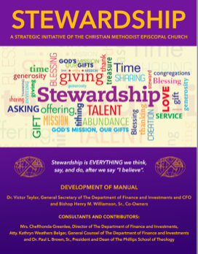
Strategic Goal 4 By June 2026, the CME Church will have provided programmatic resources and ideas to enable local churches to identify new sources of revenue (e.g., online giving, grant writing, governmental programs, etc.) aimed at increasing funds for local ministries by 10% annually beginning not later than 2022 | Strategic Initiative IV Stewardship Empowerment Initiative – designed to teach/model stewardship through the use of time, talent and resources | Co-owners Dr. Victor Taylor Bishop Henry Williamson

Slide 16
Strategic Goal 5 By June 2026, the CME Church will have leveraged external funding sources like partnerships, grants, and governmental programs to generate an additional 10% of annual funding at the connectional level beginning not later than 2022 | Strategic Initiative IV Stewardship Empowerment Initiative – designed to teach/model stewardship through the use of time, talent and resources | Co-owners Dr. Victor Taylor Bishop Henry Williamson

Slide 17
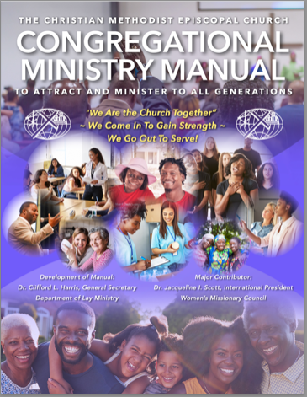
Strategic Goal 6 By June 2026, the CME Church will have engaged 75% of CME congregations in effective ministries aimed at meeting the needs of the local community in the areas of justice, health and wellness or other concerns unique to that local community. | Strategic Initiative V Congregational Ministries Manual | Co-owners Dr. Jacqueline Scott Bishop Sylvester Williams

Slide 18
Strategic Goal 6 By June 2026, the CME Church will have engaged 75% of CME congregations in effective ministries aimed at meeting the needs of the local community in the areas of justice, health and wellness or other concerns unique to that local community. | Strategic Initiative VI Measurement of Outreach Ministry | Co-owners Dr. Clifford Harris Bishop Marvin Thomas

Slide 19
Summary of Strategic Goals & Initiatives
Strategic Goals By JUNE 2026, the CME Church will have….. | Strategic Initiative | Goal(s) Supported | Passed? Yes or No? | Initiative Co-Owners
delivered and promoted a Spiritual Discipleship Ministry (SDM) in which 100% of our local churches will be active participants. | Develop & Pilot a Discipleship Program | 1 | YES | Carmichael Crutchfield Teresa Jefferson-Snorton
dramatically increased our impact internationally as evidenced by: # of focused missions and partnerships # of operationally sustainable and funded projects | Establish a clearly defined structure to consistently support and manage CME mission work. | 2 | YES | James Walker Pené Woods
increased the overall healthy church profile throughout the denomination by: Creating a Vibrant Church initiative with 80% of local pastors and churches Deploying Vibrant Church standards Planting new churches | Church Growth Initiative | 3 | YES | Thomas Brown Leon Moore
provided programmatic resources and ideas to enable local churches to identify new sources of revenue (e.g., online giving, grant writing, governmental programs, etc.) aimed at increasing funds for local ministries by 10% annually beginning not later than 2022 | Stewardship Empowerment Initiative | 4 & 5 | YES | Victor Taylor Henry Williamson
leveraged external funding sources like partnerships, grants, and governmental programs to generate an additional 10% of annual funding at the connectional level beginning not later than 2022 |  |  |  | Jacqueline Scott Sylvester Williams
engaged 75% of CME congregations in effective ministries aimed at meeting the needs of the local community in the areas of: justice, health and wellness or other concerns unique to that local community | Congregational Ministries Manual | 6 | YES | Clifford Harris Marvin Thomas
 | Measurement of Outreach Ministry |  |  | Clifford Harris Marvin Thomas

Slide 20
Critical Success Factors
Leveraging Technology
Building Capability and Capacity
Ensuring Operational Excellence

Slide 21
Strategic Planning Core Team
Juliano Andujo
Bobby Best*
Paul Brown
Thomas Brown
Kenneth Carter
Carmichael Crutchfield
Tyrone Davis
Theresa Duhart
Samson Fienko
Ian Gibson
Clifford Harris
Gregory Hudson
Teresa Jefferson-Snorton
Donald Jordan
C. James King
Othal Lakey
Roderick Lewis
Leon Moore
Zachary Mullens
Phillip Nelson
Zacheus Tieno Owang
Leo Pinkett
Quitney Pryor
Lawrence Reddick
Jacqueline Scott
Ore Spragin
Paul Stewart
Victor Taylor
Marvin Thomas
Godwin Umoette*
James Walker
Henry Williamson
Keenan Winters
Jerry Webb
Pene Woods
*Bishop Bobby Best participated as part of the Core Team until his death in August 2020.
*Bishop Godwin Umoette was a member of the Core Team until his death in February 2022.

Slide 22
Strategic Planning Core Team
YOUR NAME
Juliano Andujo
Bobby Best*
Paul Brown
Thomas Brown
Kenneth Carter
Carmichael Crutchfield
Tyrone Davis
Theresa Duhart
Samson Fienko
Ian Gibson
Clifford Harris
Gregory Hudson
Teresa Jefferson-Snorton
Donald Jordan
C. James King
Othal Lakey
Roderick Lewis
Leon Moore
Zachary Mullens
Phillip Nelson
Zacheus Tieno Owang
Leo Pinkett
Quitney Pryor
Lawrence Reddick
Jacqueline Scott
Ore Spragin
Paul Stewart
Victor Taylor
Marvin Thomas
Godwin Umoette*
James Walker
Henry Williamson
Keenan Winters
Jerry Webb
Pene Woods
*Bishop Bobby Best participated as part of the Core Team until his death in August 2020.
*Bishop Godwin Umoette was a member of the Core Team until his death in February 2022.

Slide 23
Questions/Feedback

