Slide 1
A Format for Thinking and Planning on the Fiscal Year versus the Conference Year
Presented by
Rev. Dr. Van Carl Williams
Eighth Episcopal District
Spring Convocation
March 20, 2021

Slide 2
The Issue: Producing Timely Annual Conference Audits
In 2019, (state-side) Annual Conferences of the Eighth Episcopal District were informed that auditors needed more time to produce accurate audits of Annual Conference finances than was being allowed.
Auditors asserted that they needed financial records by April 30th to perform a thorough audit by the Annual Conference(s) in July.
To comply with the auditors’ request, the Annual Conferences agreed to end the fiscal year on April 30th of each year.

Slide 3
The Issue: Producing Timely Annual Conference Audits
Conference Year
The period of time between one Annual Conference Meeting and another
Fiscal Year
A year, as determined by a body, for accounting purposes

Slide 4
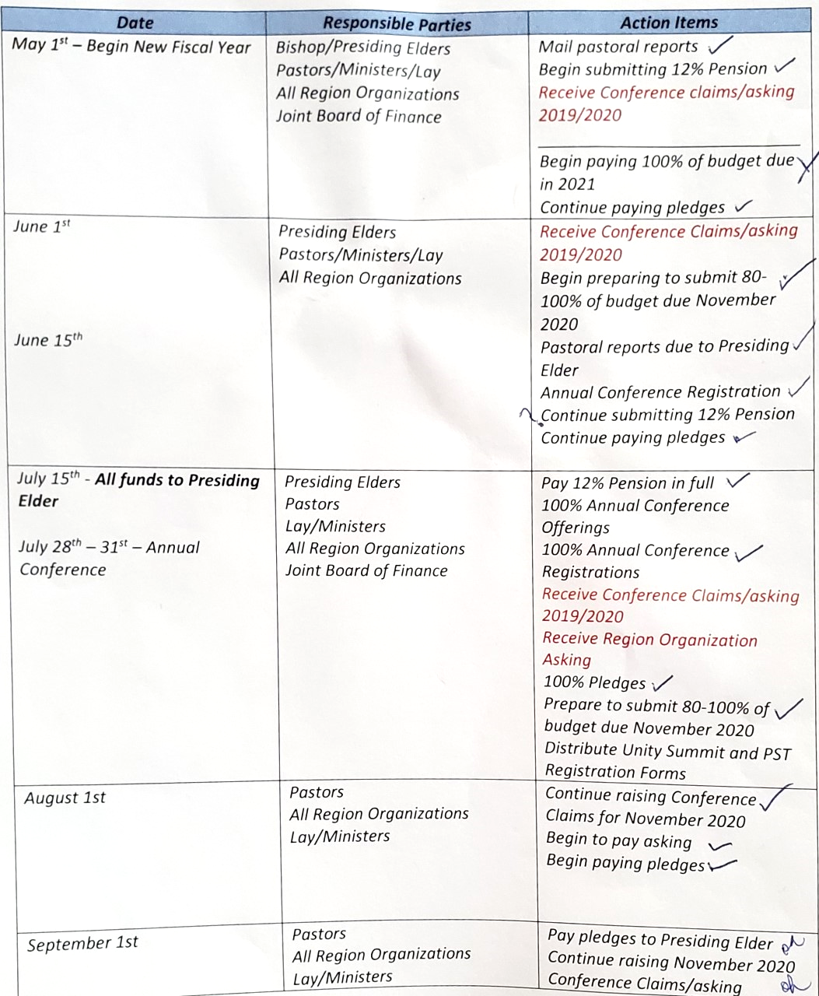
The Issue: Producing Timely Annual Conference Audits
In 2020, Presiding Elders shared with Pastors a chart delineating action items of the fiscal year.
However, some pastors (and leaders) who viewed the Presiding Elders’ chart admit they were confused.

Slide 5
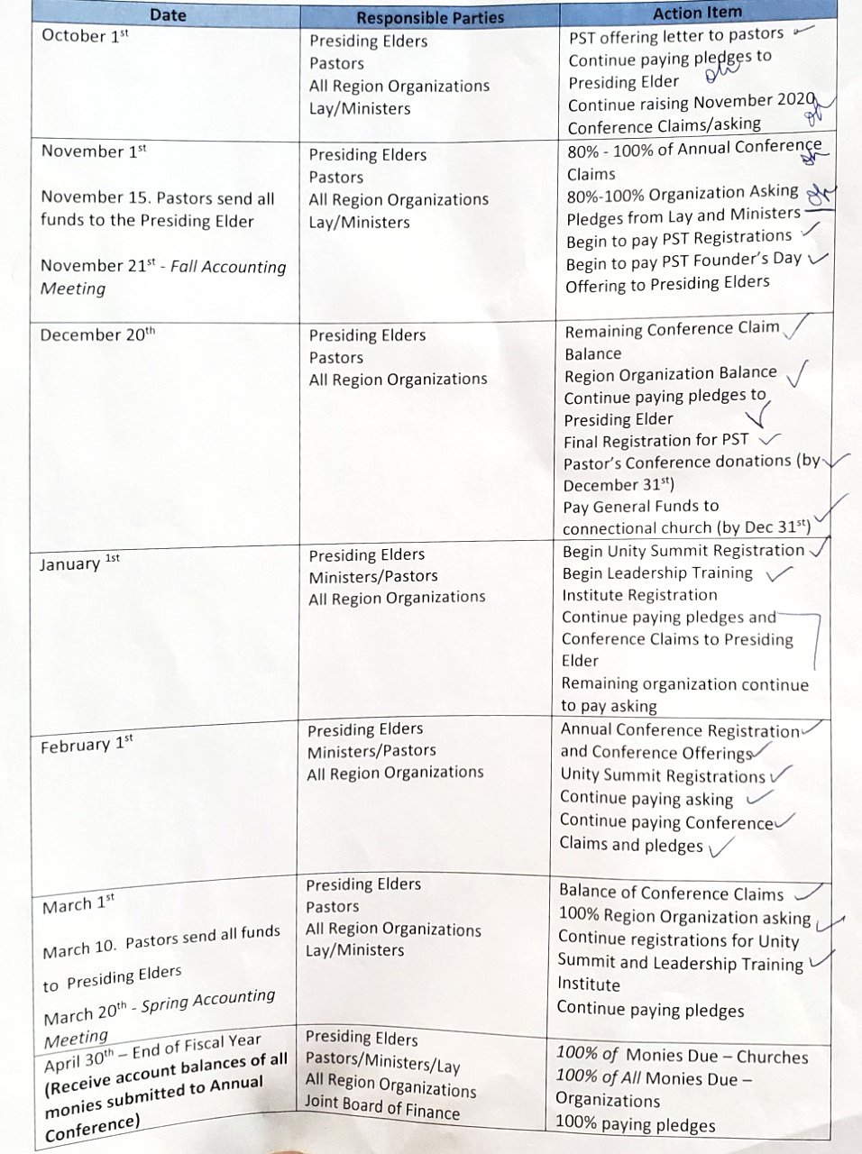
If YOU understand these charts, and the “Action Items of the new fiscal year…

Slide 6
But…for those of us who don’t fully understand the linear explanation of the Fiscal Year and its “Action Items”…

Slide 7
Watching the Clock
Although we live in the digital age, many of us still know how to tell time using the “dial clock.”

Slide 8
Watching the Clock
On the dial clock, the 12, 3, 6, and 9 positions establish quarters of an hour.

Slide 9
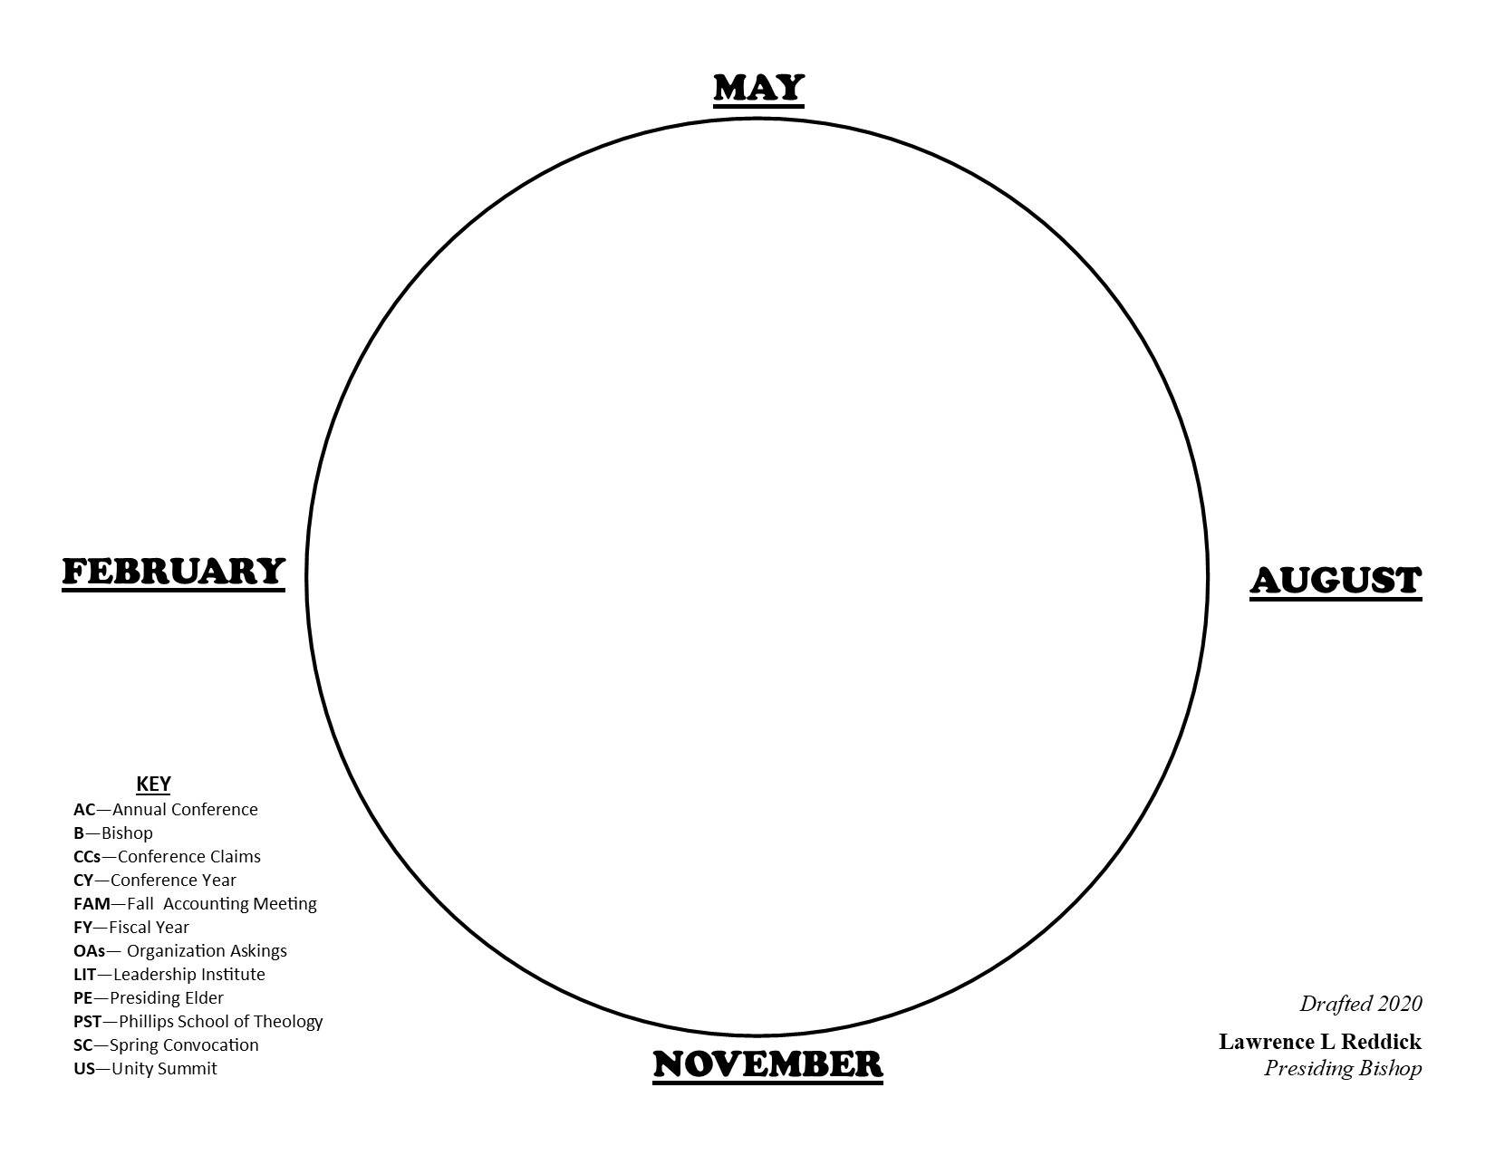
Making the Connection
12
Let’s begin by replacing the 12, 3, 6, and 9 from the dial clock with May, August, November, and February
9
3
6

Slide 10
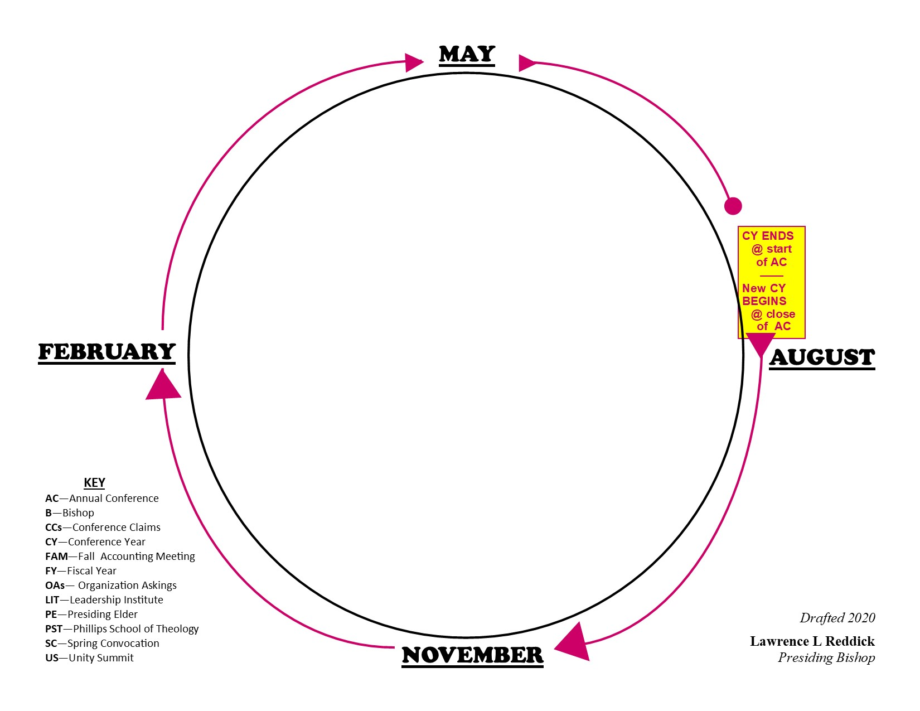
Making the Connection
12
We are used to thinking only in terms of the Conference Year.
The Conference Year ends at the start of the Annual Conference, and new Conference Year begins at the end of the Annual Conference.
9
3
6

Slide 11
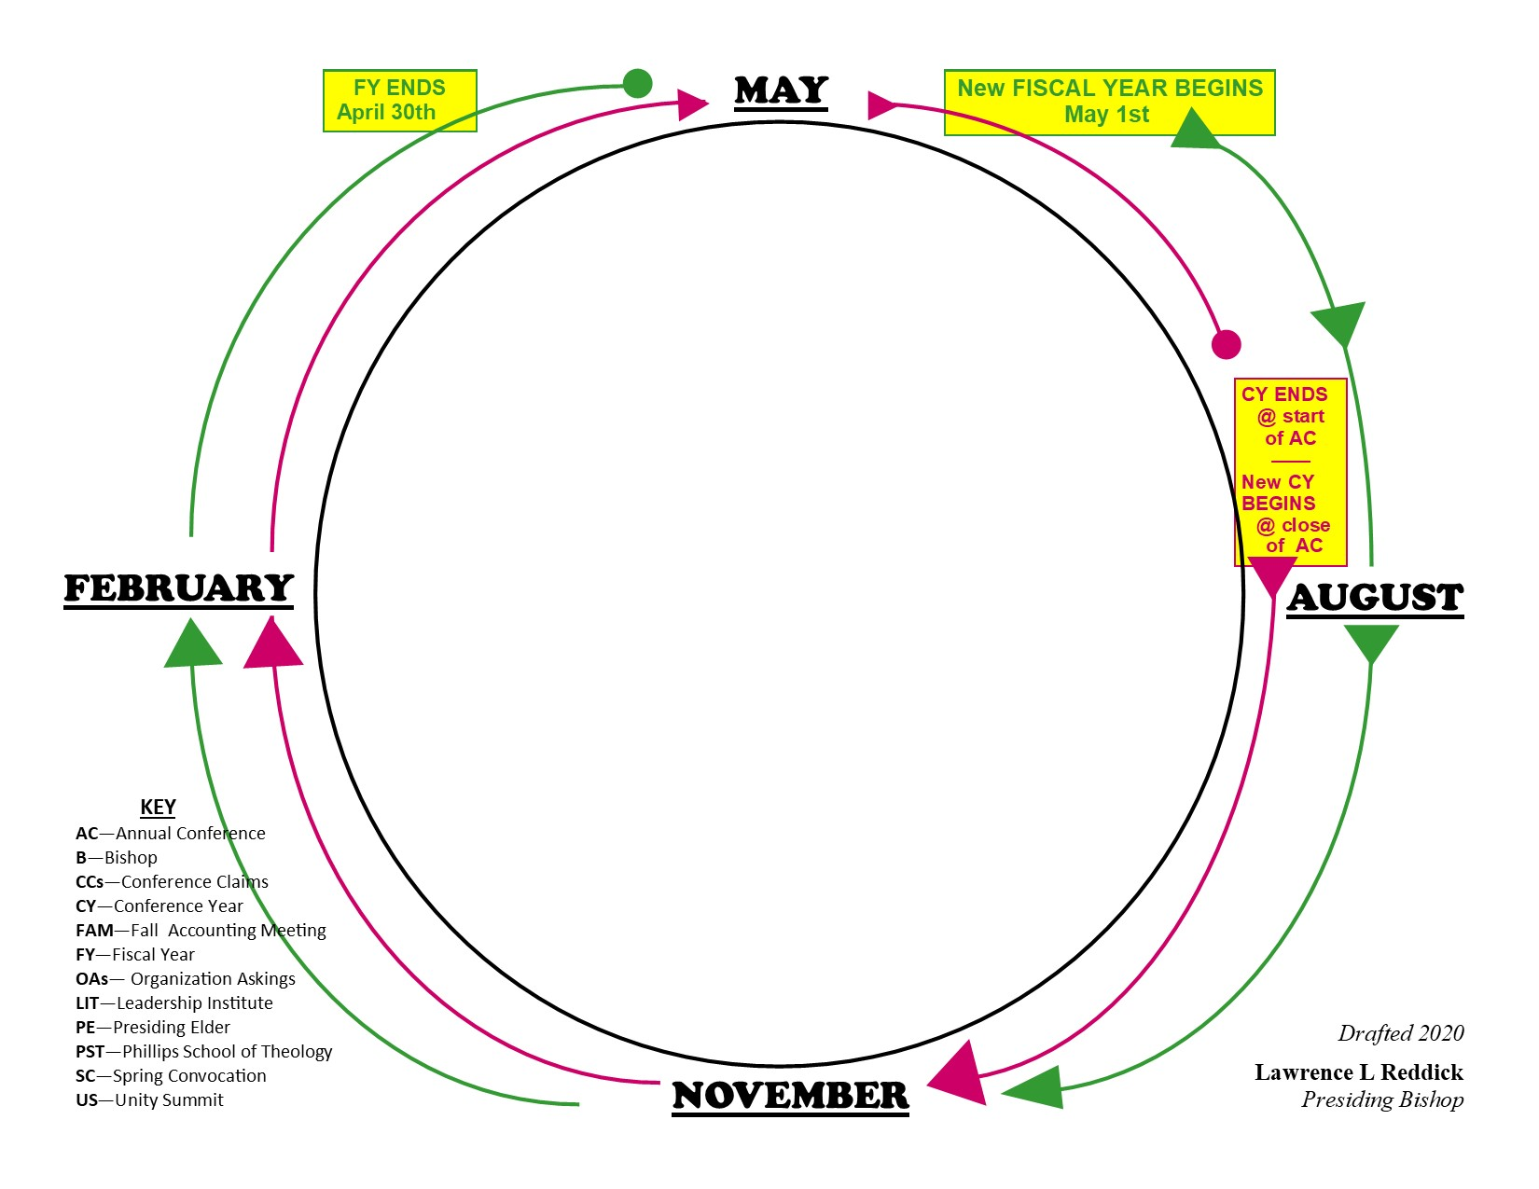
Making the Connection
12
However, for financial accounting purposes, we are now being asked to understand the fiscal year.
The Fiscal Year begins May 1st and ends April 30th.
9
3
6

Slide 12
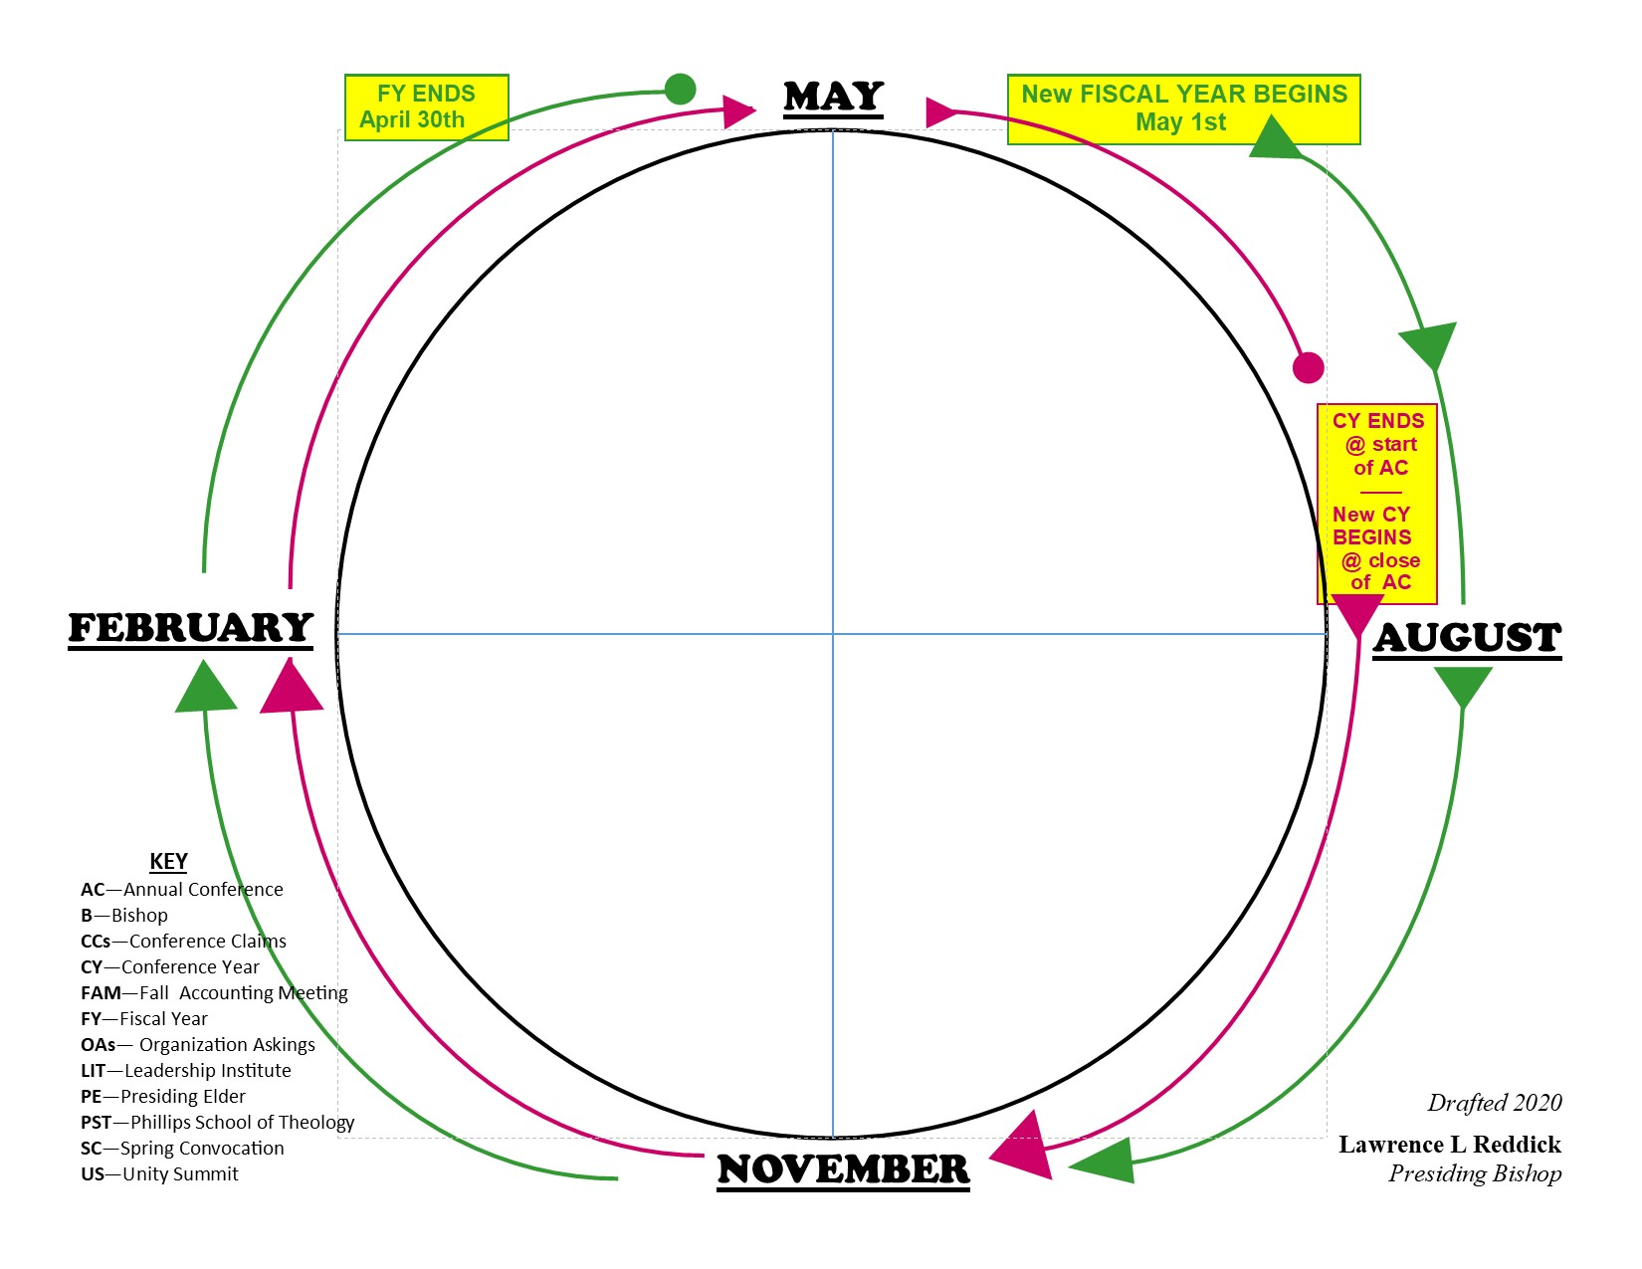
Making the Connection
4
1
Notice the Fiscal Year has 4 quarters, or QUADRANTS, just like the dial clock:
(Q1) MAY to AUGUST
(Q2) AUGUST to NOVEMBER
(Q3) NOVEMBER to FEBRUARY
(Q4) FEBRUARY to MAY
3
2

Slide 13
Quick Quiz
4
1
Which Quadrant are we in TODAY?
(Q1) MAY to AUGUST
(Q2) AUGUST to NOVEMBER
(Q3) NOVEMBER to FEBRUARY
(Q4) FEBRUARY to MAY
3
2

Slide 14
Quick Quiz
4
1
Answer
(Q4) FEBRUARY to MAY
Today is March 20th
March is in the “February to May” Quadrant
3
2

Slide 15
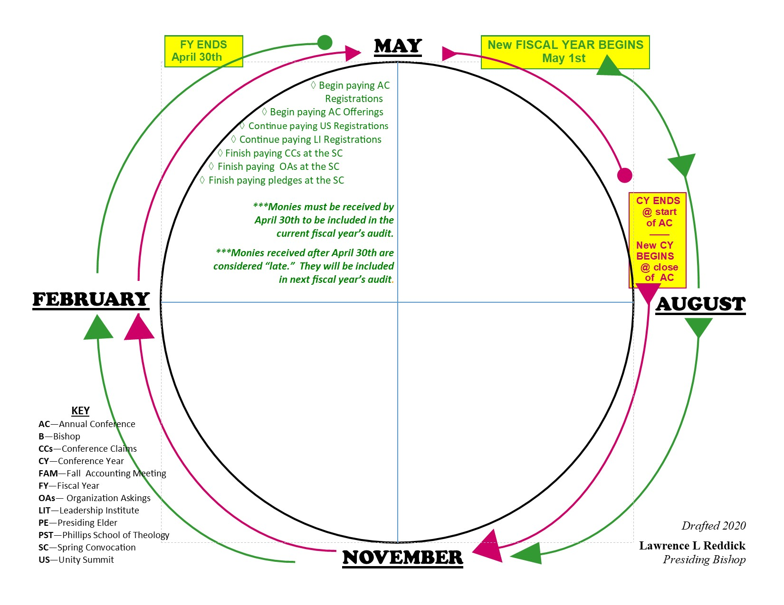
Quick Quiz
Because we’re in
(Q4) FEBRUARY to MAY
Here are the action items we ought to be completing
NOW
to be “on track” within the fiscal year

Slide 16
Key Terms
BEGIN
Get started…
CONTINUE
Keep it going…
FINISH
Get it done!!!

Slide 17
Quick Quiz
Between February and May, what can you BEGIN?
Between February and May, what can you CONTINUE?
Between February and May, what should you FINISH?

Slide 18
Quick Quiz
Why should you finish paying Conference Claims, Organizational Askings, and Pledges before April 30th?

Slide 19
So…
Let’s take a look at all of the “Action Items” within the quadrants of the fiscal year.

Slide 20
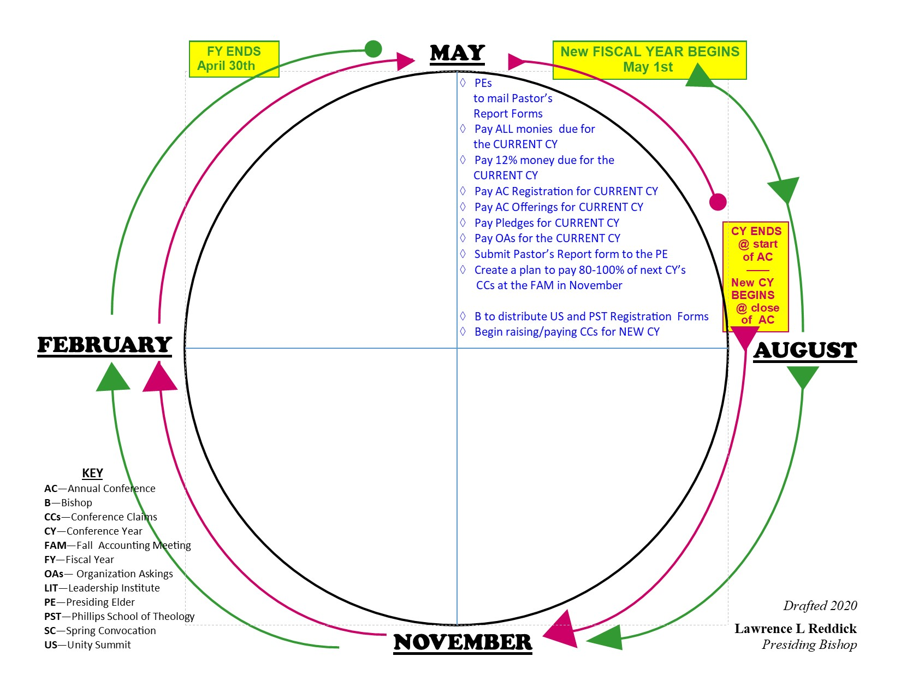
What to do in (Q1) May to August
The new FISCAL YEAR begins May 1st!
Monies reported for the current Conference Year’s Budget are considered “late” according to the Fiscal Year.
Remember: the Fiscal Year for which financial reports are being audited for the Annual Conference ended April 30^{th.}

Slide 21
What to do in (Q1) May to August
Begin reporting 12% (Pension) monies after May 1st
Create a plan to report at least 80% of your “new” Conference Claims at the Fall Accounting Meeting

Slide 22
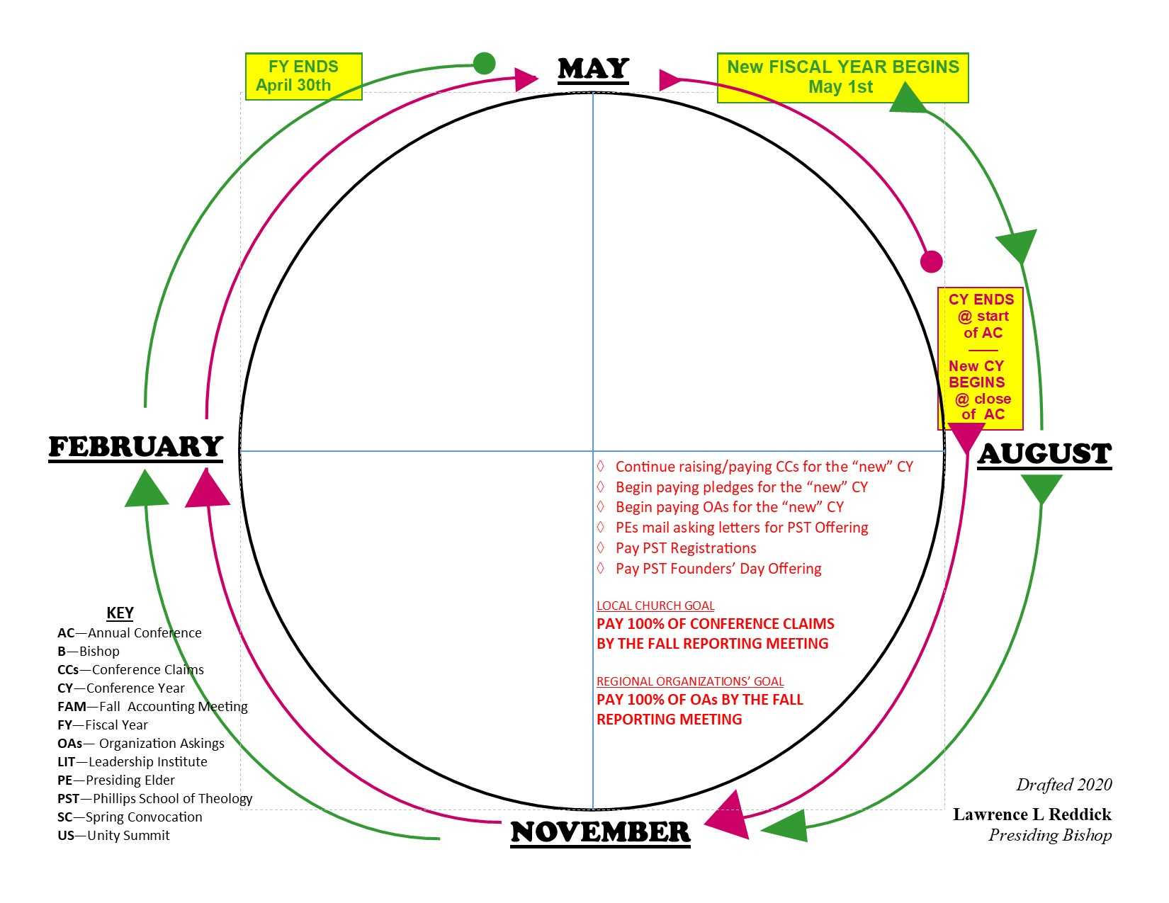
What to do in (Q2) August to November
Continue raising and reporting Conference Claims for the “new” Conference Year
Begin paying pledges and Organizational Askings for the “new” Conference Year
WORK TOWARDS THE GOAL: 100% at the Fall Accounting Meeting!

Slide 23
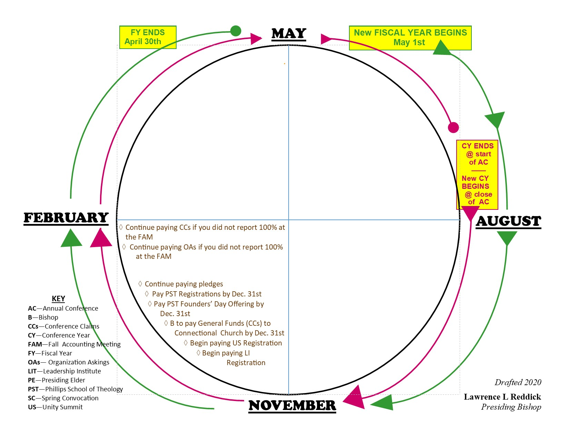
What to do in (Q3) November to February
If you didn’t report 100% at the Fall Accounting Meeting, continue paying.
The Bishop must pay the General Funds (Conference Claims) to the Connectional Church by Dec. 31st!

Slide 24
What to do in (Q4) February to May
Finish paying the balance of Conference Claims, Organizational Askings, and Pledges at the Spring Convocation
Begin paying Annual Conference registrations and offerings
All Annual Conference monies (except the 12% Pension) must be received by April 30th to be included in the current Fiscal Year’s Audit. (The audit will be presented at the Annual Conference in July).
Pay the 12% Pension after May 1st

Slide 25
Recap
(Q1) MAY to AUGUST

Slide 26
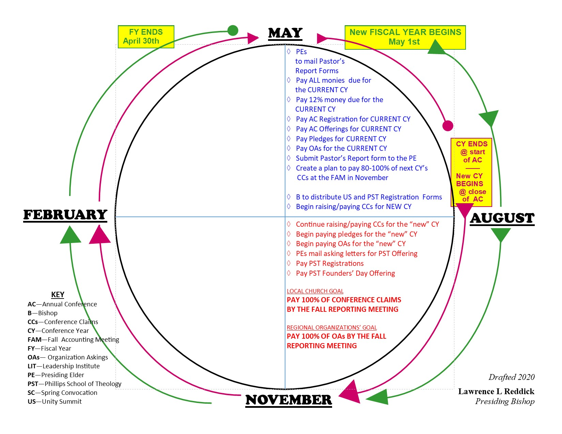
Recap
(Q1) MAY to AUGUST
(Q2) AUGUST to NOVEMBER

Slide 27
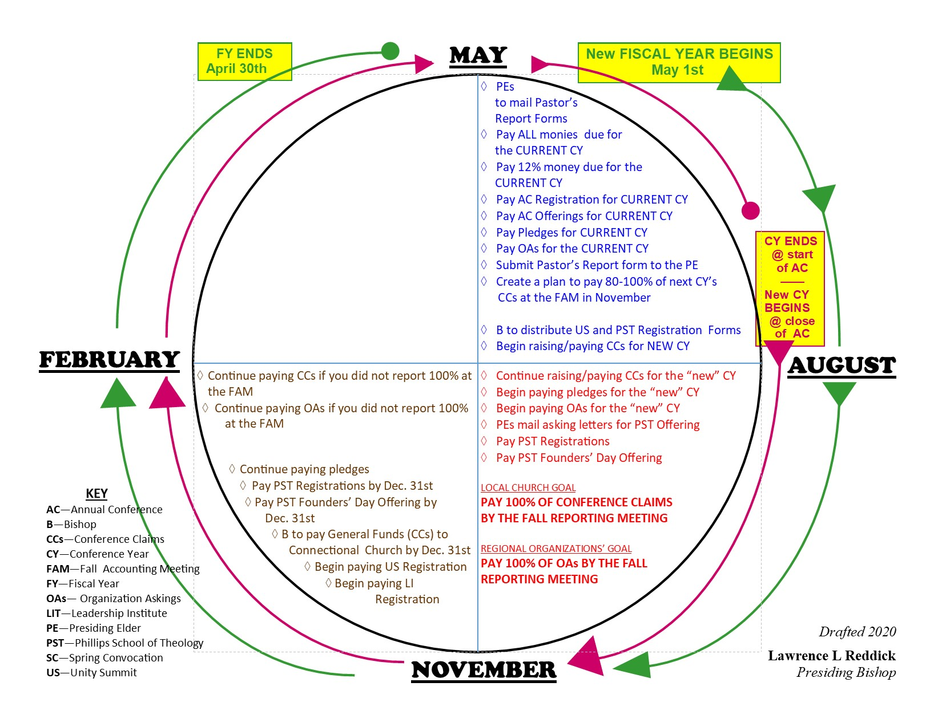
Recap
(Q1) MAY to AUGUST
(Q2) AUGUST to NOVEMBER
(Q3) NOVEMBER to FEBRUARY

Slide 28
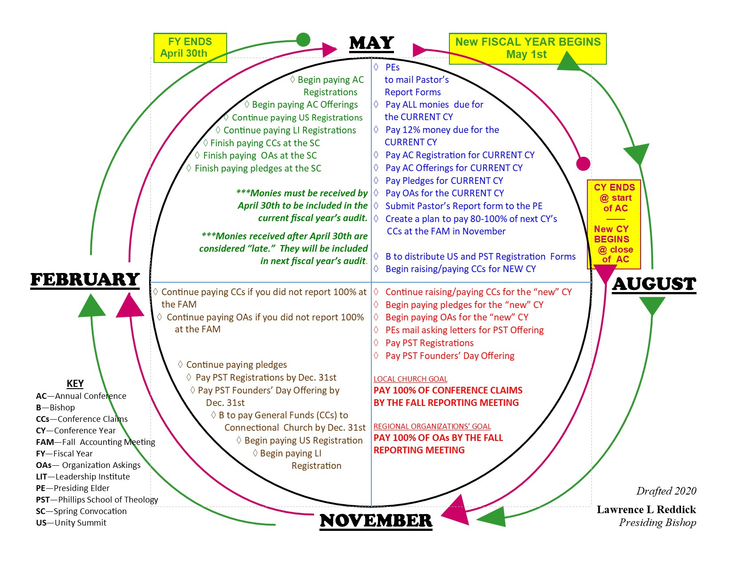
Recap
(Q1) MAY to AUGUST
(Q2) AUGUST to NOVEMBER
(Q3) NOVEMBER to FEBRUARY
(Q4) FEBRUARY to MAY

